Slide 1
ENSE 470, Milestone 4
Tiger Vikings
Samuel Iregbu
Christian Anwanaodung
Jay Denesik
Uys Kriek
March 1st, 2018

Slide 2
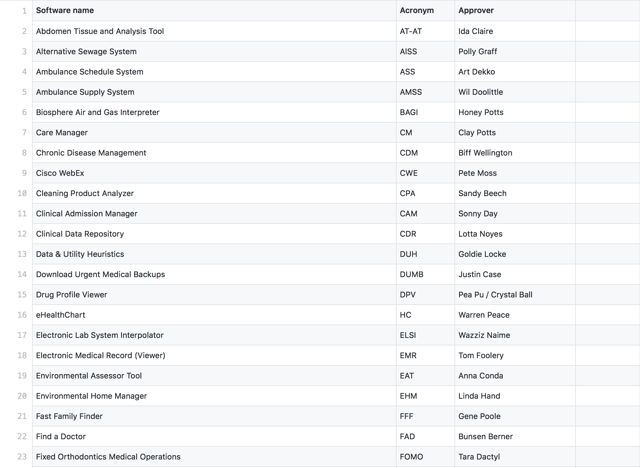
Database snapshot

Slide 3
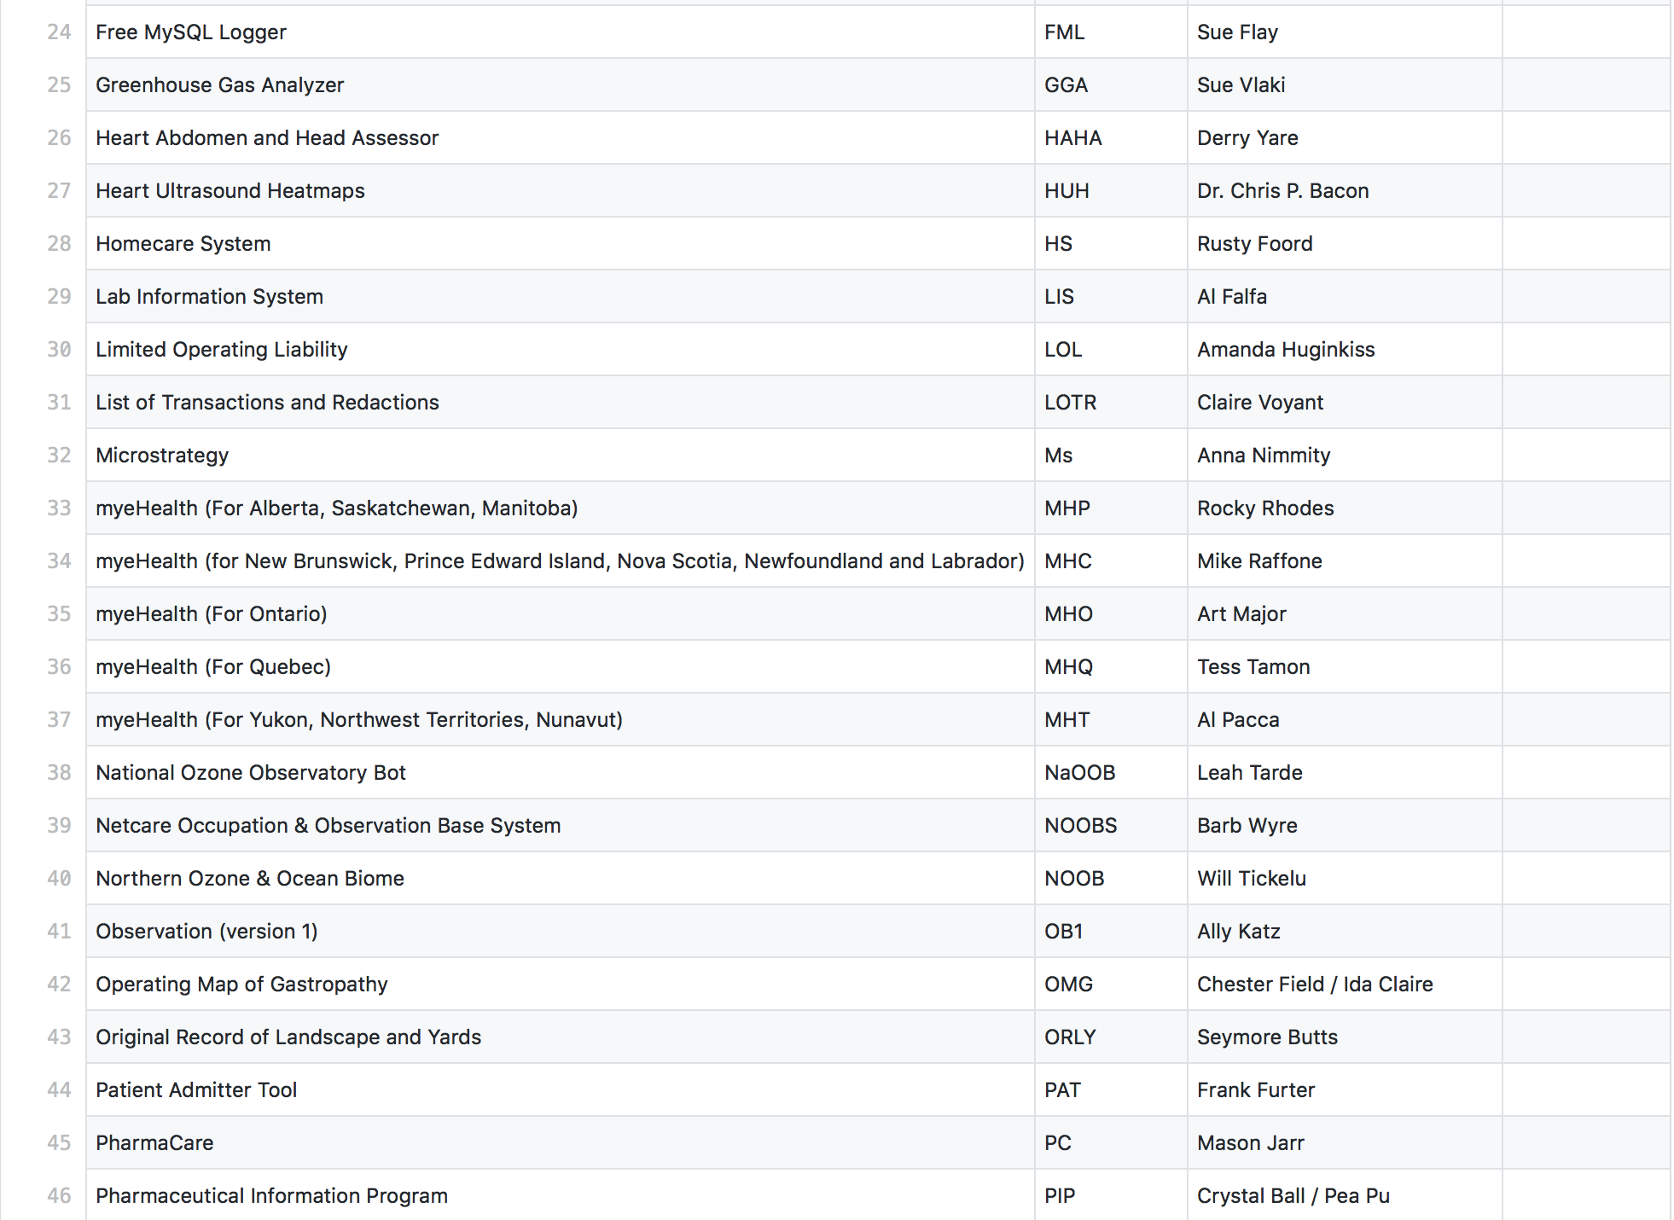
Database snapshot

Slide 4
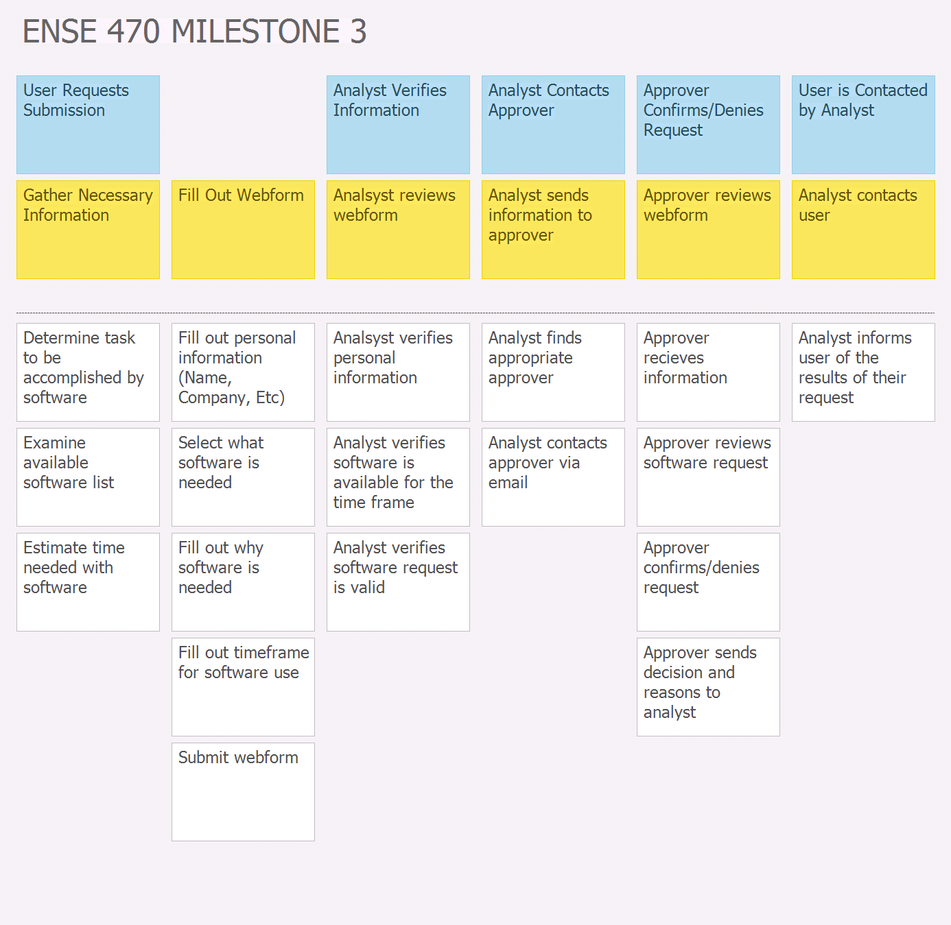
Changes & Misc.

Slide 5
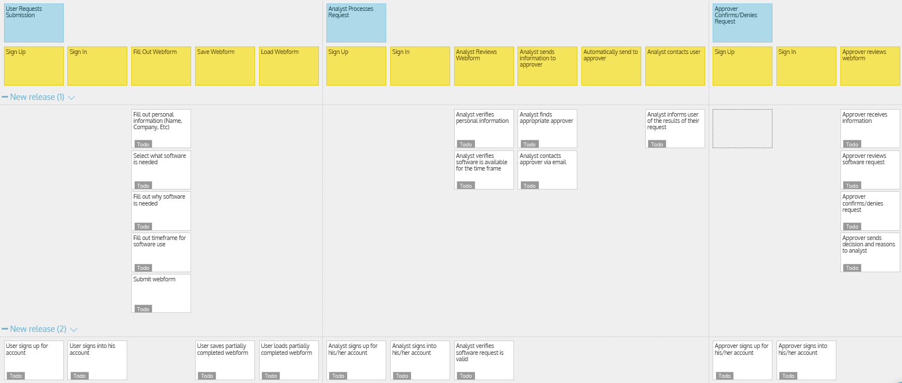
Recall, user story map

Slide 6
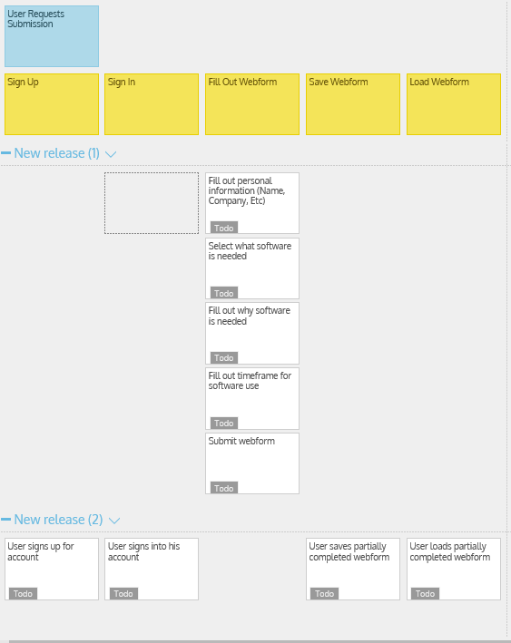
Recall, user story map

Slide 7
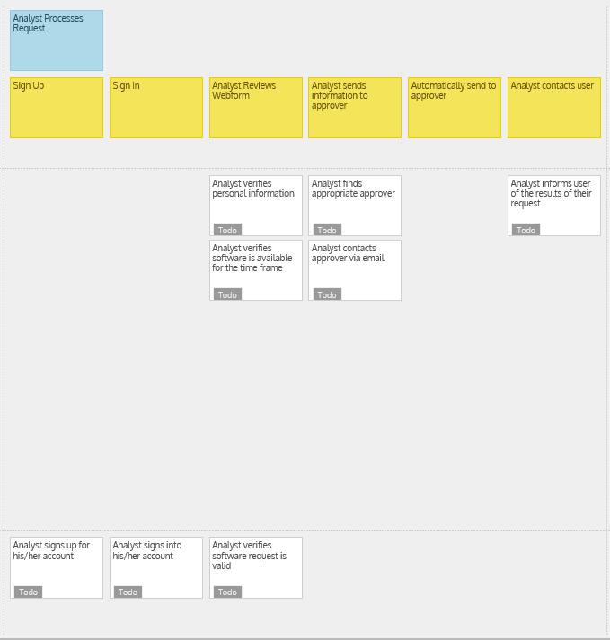
Recall, user story map

Slide 8
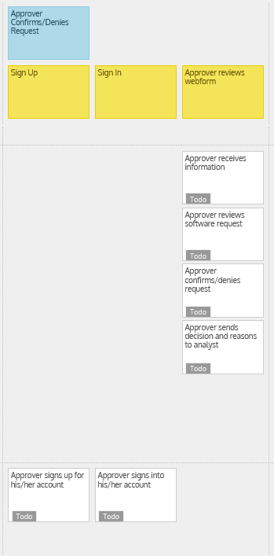
Recall, user story map

Slide 9
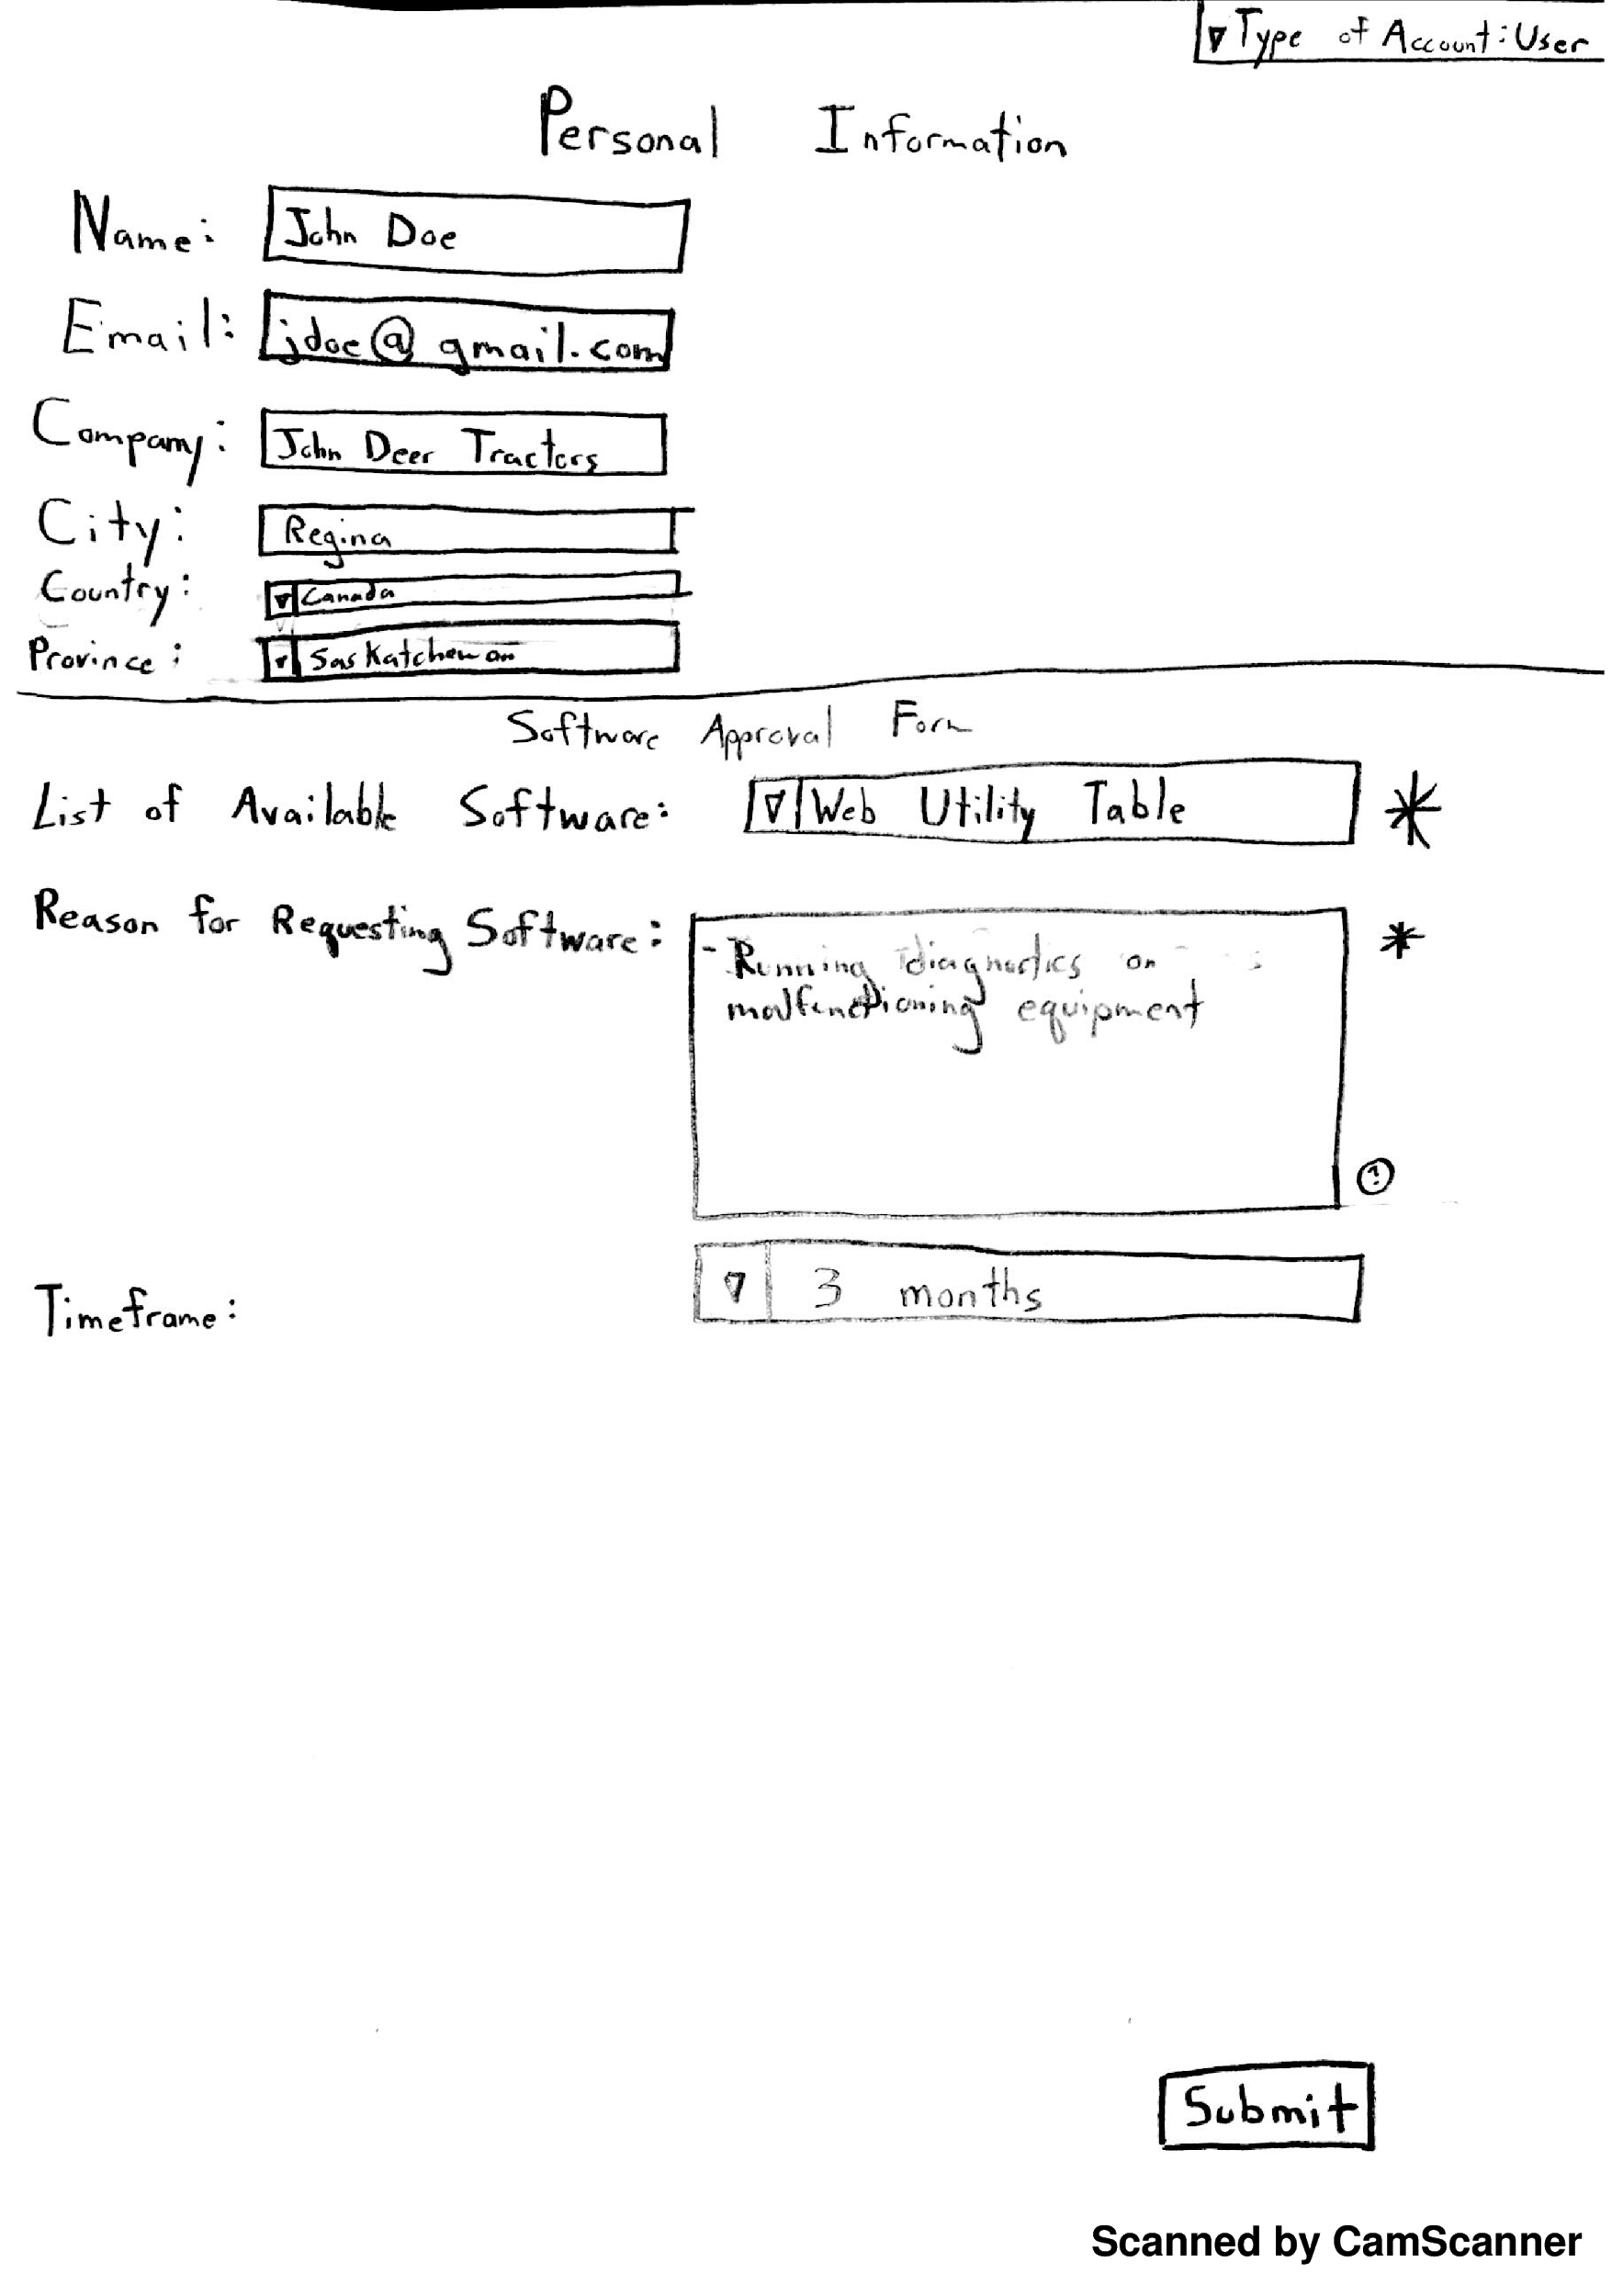
Lo-fidelity prototype snapshots

Slide 10
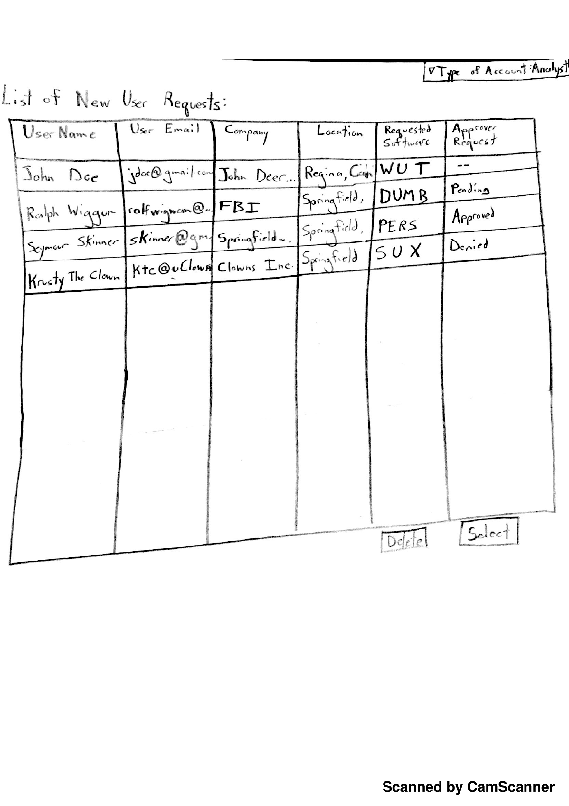
Lo-fidelity prototype snapshots

Slide 11
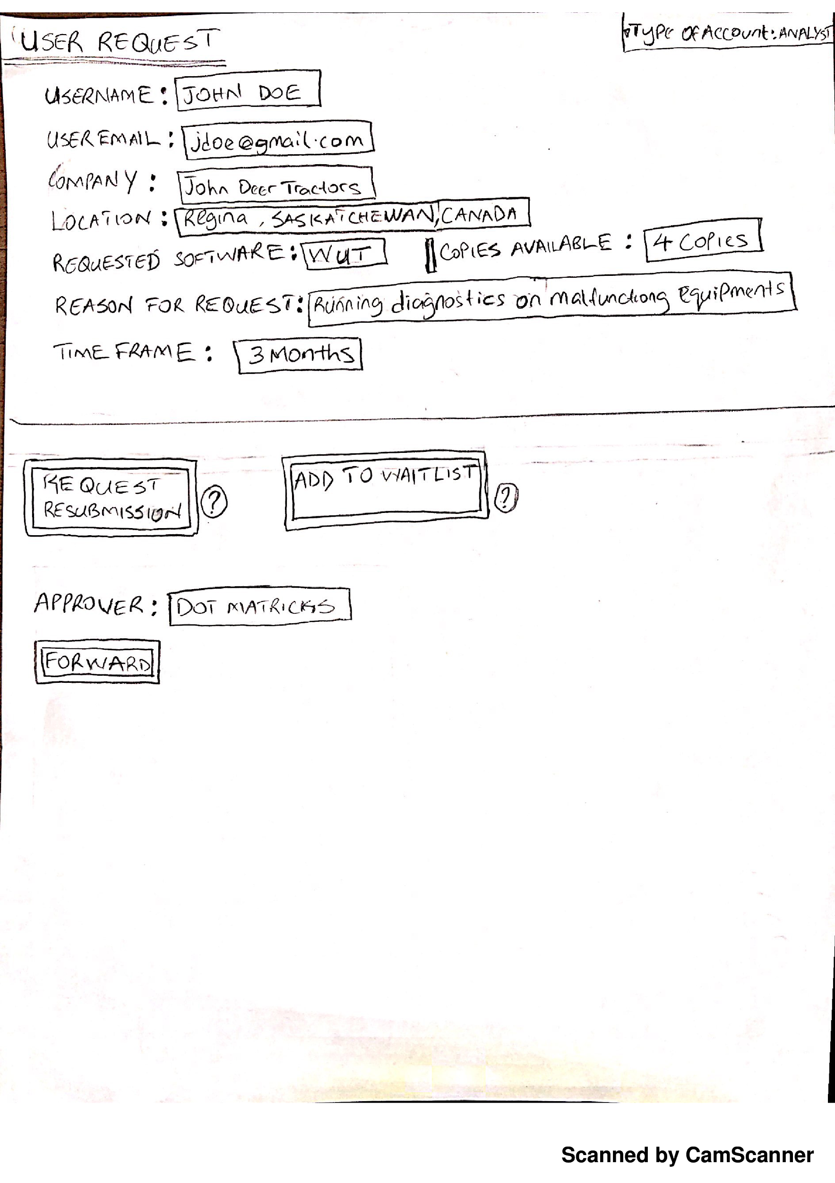
Lo-fidelity prototype snapshots

Slide 12
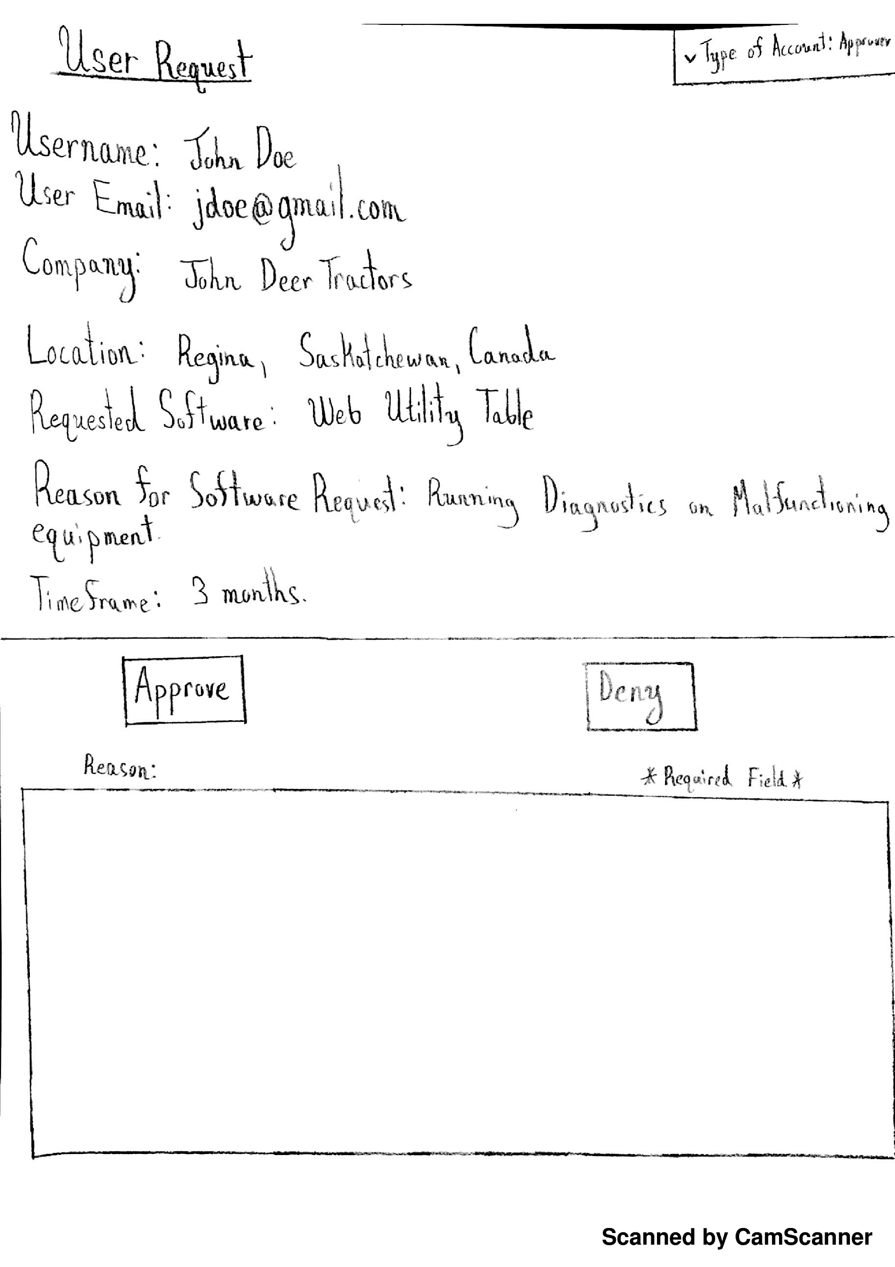
Lo-fidelity prototype snapshots

Slide 13
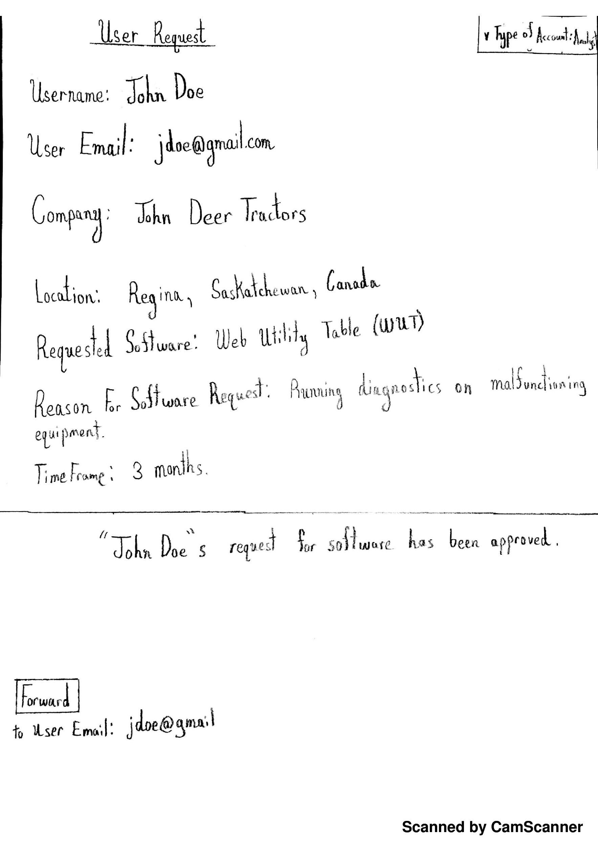
Lo-fidelity prototype snapshots

Slide 14
Group Reflection
How did you feel about this milestone? What did you like about it? What did you dislike?
We thought this milestone was very hands on. We like the flexibility of Lo-fi prototyping.
What did you learn about yourself as you collaborated and worked through this milestone?
We learned how to work together as a group. We have gotten very good at splitting up work and brainstorming through ideas.
How will you use what you have learned going forward?
We will use lo-fidelity prototyping as the first step in designing any new software
What “stuff & things” related to this milestone would you want help with?
More examples of lo-fi prototyping

